Slide 1
Mr. Ulcena
6th - 8th Math
Week at a Glance 09/13-09/17

Slide 2
Welcome back to school class of 2021-2022
WAG=WEEK AT A GLANCE
Week at a glance (WAG) is designed to give parents a brief idea of what their child is learning at school. It will have the subject standards (Georgia Standards of Excellence), the main topics covered, links to videos and worksheets.
We encourage parents to review this presentation and stay informed on the weekly learning objectives.
WAGS are subject to change according to student mastery.

Slide 3
Math standards
6th Grade
Unit 2
Rate, Ratio and Proportional Reasoning Using Fractions
Priority Standard
6.RP.3 a, b, c, & d
Big Ideas:
Use tables, bar models, double number line diagrams and/or equations with ratios and rates to solve real world problems.
Vocabulary:
Fraction, Rate, Ratio, Proportional
7th Grade
Unit 2
Expressions and Equations
Priority Standards
7.EE.1
7.EE.3
7.EE.4a, b, & c
Big Ideas:
Use properties to add/subtract/factor/expand expressions and equations.
Solve multi-step real-world problems and mathematical problems using numerical and algebraic expressions and equations (EE.3-4)
Vocabulary:
Expressions, Equations
8th Grade
Unit 2
Geometric Applications of Exponents
Priority Standards
8.G.7
8.G.9
Big Ideas:
Understand and apply the Pythagorean Theorem.
Solve real-world and mathematical problems involving volume of cylinders, cones, and spheres.
Vocabulary:
Pythagorean Theorem

Slide 4
Monday 6th Grade Use tables, bar models, double number line diagrams and/or equations with ratios and rates to solve real world problems. PowerPoint presentation/Note taking 7th Grade Use properties to add/subtract/factor/expand expressions and equations. Solve multi-step real-world problems and mathematical problems using numerical and algebraic expressions and equations PowerPoint presentation/Note taking 8th Grade Understand and apply the Pythagorean Theorem PowerPoint presentation/Note taking | Tuesday 6th Grade Use tables, bar models, double number line diagrams and/or equations with ratios and rates to solve real world problems. PowerPoint presentation/Note taking 7th Grade Use properties to add/subtract/factor/expand expressions and equations. Solve multi-step real-world problems and mathematical problems using numerical and algebraic expressions and equations PowerPoint presentation/Note taking 8th Grade Understand and apply the Pythagorean Theorem PowerPoint presentation/Note taking | Wednesday Small Group/Remediation | Thursday I-Ready Lessons Diagnostic Assessment – ALL grade level | Friday Assessment/ PBIS (Positive Behavioral Interventions and Support program)

Slide 5
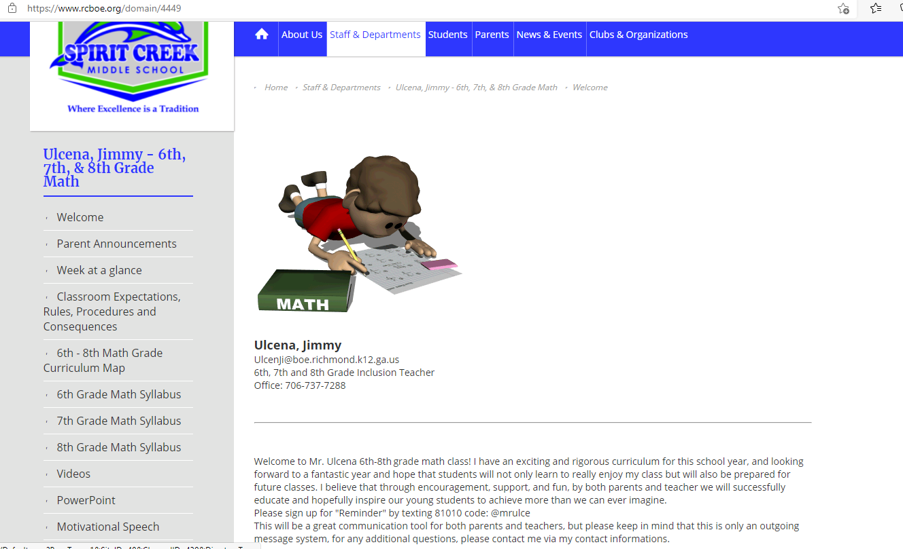

math Resources
For additional resources and weekly PowerPoint and videos click on link to Mr. Ulcena Teacher’s Page
https://www.rcboe.org/domain/4449
Khan Academy
https://www.khanacademy.org/

